Slide 1
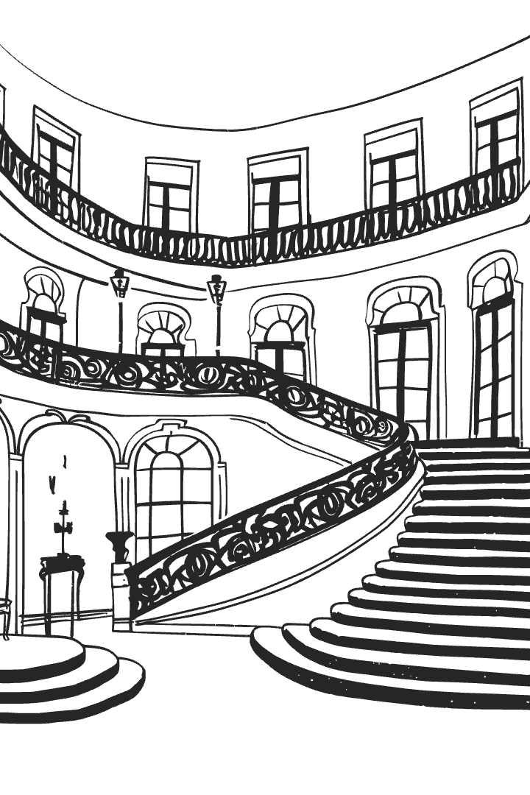
Advanced Programming Techniques – Week 3
Structural Design Patterns

Slide 2
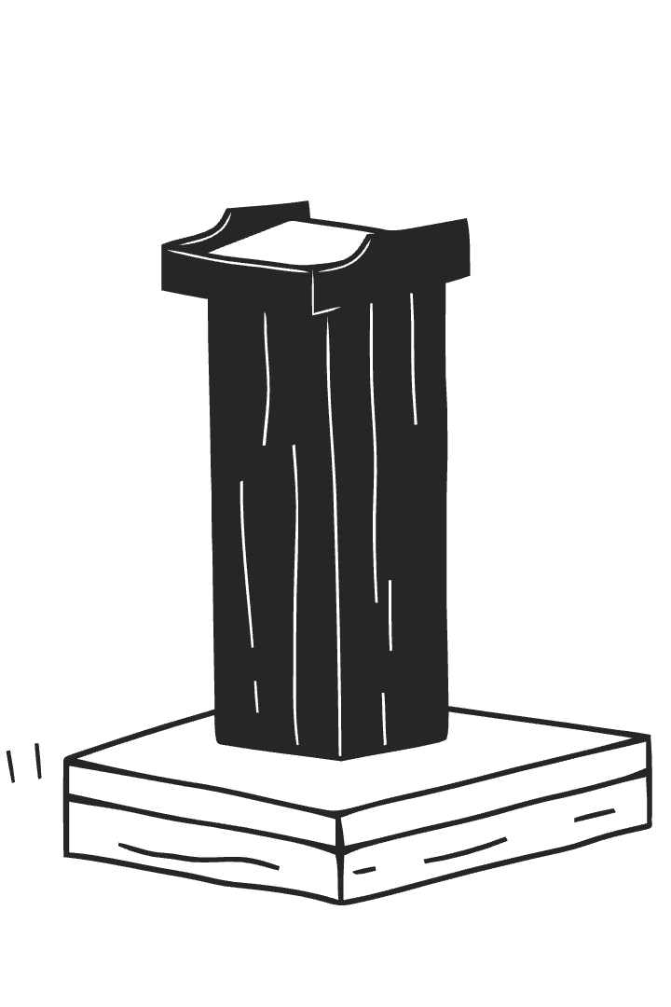
Overview
Structural design patterns focus on how classes and objects are composed
These patterns simplify object relationships and improve the organization of code in a scalable way.
Topics Covered:
1. Adapter – Converts one interface into another
2. Bridge – Decouples abstraction from implementation
3. Composite – Treats a group of objects as a single entity
4. Decorator – Dynamically extends object behavior
5. Facade – Provides a simplified interface to a complex system
6. Proxy – Controls access to another object
7. Flyweight – Optimizes memory by sharing objects

Slide 3
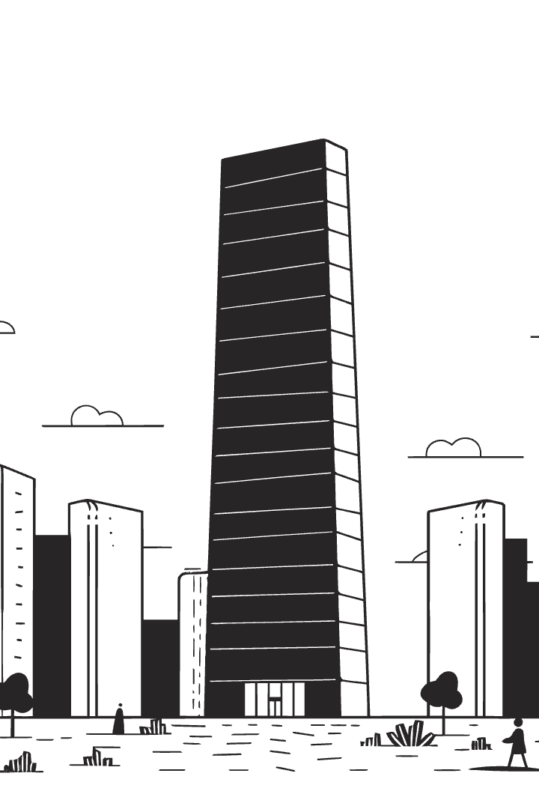
Introduction to Structural Design Patterns
Definition:
Structural design patterns focus on composing classes and objects to create large, scalable architectures while maintaining flexibility and efficiency.
Why Use Structural Patterns?
✅ Improve code reuse and modularity
✅ Enhance scalability and flexibility
✅ Reduce tight coupling between classes
✅ Promote separation of concerns

Slide 4
1️⃣ Adapter Pattern
Purpose
📌 Java Example
The Adapter pattern allows objects with incompatible interfaces to work together. It acts as a middle layer that translates one interface into another.
// Old interface (Legacy Code)
class OldSystem {
void oldMethod() { System.out.println("Using the old system"); }
}
// New interface (Client expects this)
interface NewInterface { void newMethod(); }
// Adapter to make OldSystem work with NewInterface
class Adapter implements NewInterface {
private OldSystem oldSystem;
public Adapter(OldSystem oldSystem) { this.oldSystem = oldSystem; }
@Override
public void newMethod() { oldSystem.oldMethod(); }
}
// Client Code
public class AdapterExample {
public static void main(String[] args) {
NewInterface adapter = new Adapter(new OldSystem());
adapter.newMethod(); // Works with the new interface
}
}
🔹 When to Use Adapter?
When integrating legacy code into a new system.
When using third-party libraries with different interfaces.
UML Diagram
classDiagram
class Target { +request() }
class Adapter { +request() }
class Adaptee { +specificRequest() }
Target <|.. Adapter
Adapter ..|> Adaptee

Slide 5



Adapter Pattern: Pros and Cons
Advantages
Pitfalls
Enables compatibility between incompatible interfaces
Can introduce additional complexity
May lead to performance overhead
Encourages code reuse

Slide 6
2️⃣ Bridge Pattern
Purpose
UML Diagram (Mermaid.js)
The Bridge pattern separates abstraction from implementation, allowing them to be developed independently.
classDiagram
class Abstraction { +Implementation impl +operation() }
class Implementation { +operationImpl() }
class ConcreteImplementationA { +operationImpl() }
class ConcreteImplementationB { +operationImpl() }
Abstraction --> Implementation
Implementation <|-- ConcreteImplementationA
Implementation <|-- ConcreteImplementationB

Slide 7
Bridge Pattern Example
interface Color { void applyColor(); }
class Red implements Color {
public void applyColor() { System.out.println("Applying red color"); }
}
abstract class Shape {
protected Color color;
public Shape(Color color) { this.color = color; }
abstract void draw();
}
class Circle extends Shape {
public Circle(Color color) { super(color); }
public void draw() {
System.out.print("Drawing Circle with ");
color.applyColor();
}
}
public class BridgeExample {
public static void main(String[] args) {
Shape redCircle = new Circle(new Red());
redCircle.draw();
}
}

Slide 8
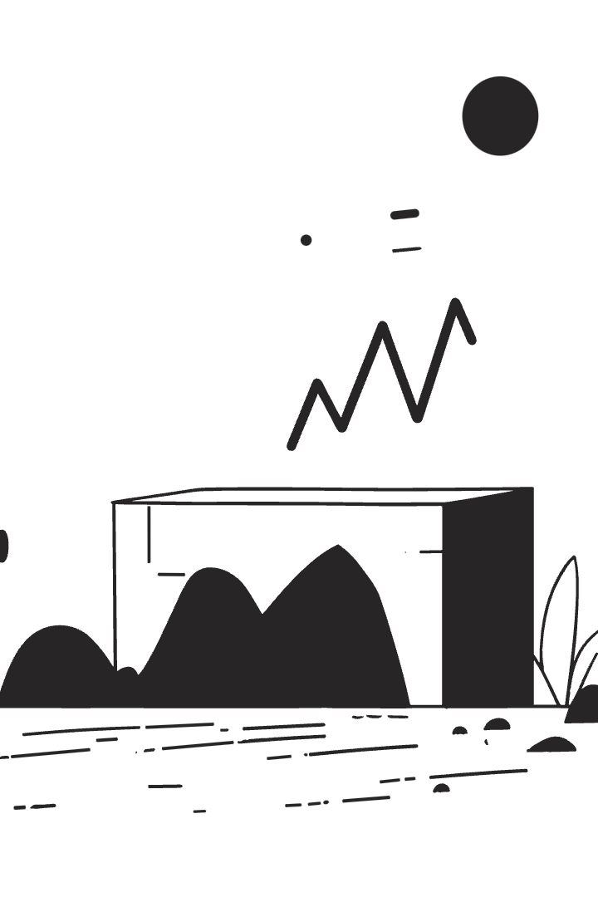
Bridge Pattern: Pros and Cons
1
2
Advantages
Benefits
Decouples abstraction from implementation
Makes systems scalable and maintainable
1
Pitfalls
Complexity may increase if not necessary

Slide 9
3️⃣ Composite Pattern
📌 Purpose
📌 UML Diagram (Mermaid.js)
The Composite pattern allows treating a group of objects the same way as individual objects.
classDiagram
class Component { +operation() }
class Leaf { +operation() }
class Composite {
+operation()
+add(Component)
+remove(Component)
}
Component <|-- Leaf
Component <|-- Composite

Slide 10
Composite Pattern Example
interface Component { void showDetails(); }
class Leaf implements Component {
private String name;
public Leaf(String name) {
this.name = name;
}
public void showDetails() {
System.out.println(name);
}
}
class Composite implements Component {
private List children = new ArrayList<>();
public void add(Component component) { children.add(component); }
public void showDetails() {
for (Component component: children) {
component.showDetails();
}
}
}
public class CompositeExample {
public static void main(String[] args) {
Composite folder = new Composite();
folder.add(new Leaf("File 1"));
folder.add(new Leaf("File 2"));
folder.showDetails();
}
}

Slide 11
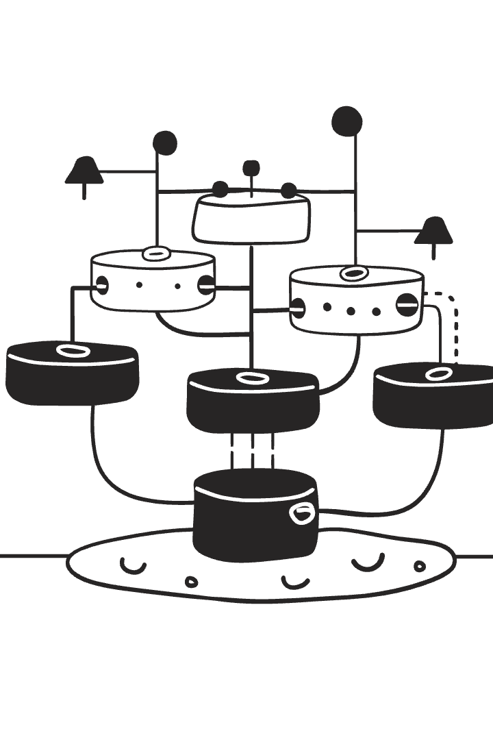
Composite Pattern: Pros and Cons
✅ Advantages
Simplifies working with hierarchical structures.
Supports recursive operations.
⚠️ Pitfalls
Can complicate debugging.

Slide 12
4️⃣ Decorator Pattern
📌 Purpose
📌 UML Diagram (Mermaid.js)
The Decorator pattern allows you to dynamically extend the functionality of an object without modifying its structure.
classDiagram
class Component { +operation() }
class ConcreteComponent { +operation() }
class Decorator { +Component component +operation() }
class ConcreteDecoratorA { +operation() }
class ConcreteDecoratorB { +operation() }
Component <|-- ConcreteComponent
Component <|-- Decorator
Decorator <|-- ConcreteDecoratorA
Decorator <|-- ConcreteDecoratorB
Decorator --> Component
🔹 When to Use Decorator?
When you need to add responsibilities dynamically to objects.
When subclassing would create too many subclasses.

Slide 13
Decorator Pattern Example
interface Component { void operation(); }
class ConcreteComponent implements Component {
public void operation() {
System.out.println("Basic operation");
}
}
class Decorator implements Component {
protected Component component;
public Decorator(Component component) {
this.component = component;
}
public void operation() {
component.operation();
}
}
class ConcreteDecoratorA extends Decorator {
public ConcreteDecoratorA(Component component) {
super(component);
}
public void operation() {
super.operation();
System.out.println("Adding feature A");
}
}
public class DecoratorExample {
public static void main(String[] args) {
Component decorated = new ConcreteDecoratorA(new ConcreteComponent());
decorated.operation();
}
}
✅ Advantages
⚠️ Pitfalls
Adds behavior dynamically at runtime.
May lead to complexity if overused.
Avoids subclass explosion.

Slide 14
5️⃣ Facade Pattern
📌 Purpose
📌 UML Diagram (Mermaid.js)
The Facade pattern hides the complexity of a subsystem and provides a simplified interface for clients.
classDiagram
class Facade { +operation() }
class SubsystemA { +operationA() }
class SubsystemB { +operationB() }
Facade --> SubsystemA
Facade --> SubsystemB

Slide 15
Facade Pattern Example
class SubsystemA {
void operationA() {
System.out.println("Subsystem A operation");
}
}
class SubsystemB {
void operationB() {
System.out.println("Subsystem B operation");
}
}
class Facade {
private SubsystemA a = new SubsystemA();
private SubsystemB b = new SubsystemB();
public void operation() {
a.operationA();
b.operationB();
}
}
public class FacadeExample {
public static void main(String[] args) {
Facade facade = new Facade();
facade.operation(); // Simplified interface
}
}
✅ Advantages
⚠️ Pitfalls
Simplifies complex systems.
Hides functionality, which might reduce flexibility.
Reduces dependencies on multiple subsystems.

Slide 16
6️⃣ Flyweight Pattern
📌 Purpose
📌 UML Diagram (Mermaid.js)
The Flyweight pattern optimizes memory usage by sharing objects instead of creating new instances.
classDiagram
class Flyweight { +operation(extrinsicState) }
class ConcreteFlyweight { +operation(extrinsicState) }
class FlyweightFactory { +getFlyweight() }
Flyweight <|-- ConcreteFlyweight
FlyweightFactory --> Flyweight

Slide 17
Flyweight Pattern Example
interface Flyweight {
void operation(String extrinsicState);
}
class ConcreteFlyweight implements Flyweight {
private String intrinsicState;
public ConcreteFlyweight(String intrinsicState) {
this.intrinsicState = intrinsicState;
}
public void operation(String extrinsicState) {
System.out.println("Intrinsic: " + intrinsicState +
", Extrinsic: " + extrinsicState);
}
}
class FlyweightFactory {
private Map cache = new HashMap<>();
public Flyweight getFlyweight(String key) {
if (!cache.containsKey(key)) {
cache.put(key, new ConcreteFlyweight(key));
}
return cache.get(key);
}
}
public class FlyweightExample {
public static void main(String[] args) {
FlyweightFactory factory = new FlyweightFactory();
Flyweight shared1 = factory.getFlyweight("SharedState");
shared1.operation("Instance1");
Flyweight shared2 = factory.getFlyweight("SharedState");
shared2.operation("Instance2");
}
}
✅ Advantages
⚠️ Pitfalls
Reduces memory consumption by reusing objects.
Complex to implement.

Slide 18
7️⃣ Proxy Pattern
📌 Purpose
📌 UML Diagram (Mermaid.js)
The Proxy pattern provides a placeholder for another object to control access to it.
classDiagram
class Subject { +request() }
class RealSubject { +request() }
class Proxy { +request() }
Subject <|-- RealSubject
Subject <|-- Proxy
Proxy --> RealSubject

Slide 19
Proxy Pattern Example
interface Subject { void request(); } class RealSubject implements Subject { public void request() { System.out.println("RealSubject handling request"); } }
class Proxy implements Subject {
private RealSubject realSubject;
public void request() {
if (realSubject == null) {
realSubject = new RealSubject();
}
System.out.println("Proxy controls access to RealSubject");
realSubject.request();
}
}
public class ProxyExample {
public static void main(String[] args) {
Subject proxy = new Proxy();
proxy.request(); // Proxy controls access
}
}
✅ Advantages
⚠️ Pitfalls
Adds security & lazy initialization.
May introduce latency.

Slide 20


Comparison: Facade vs. Proxy Pattern
Aspect
Facade
Proxy
Purpose
Simplifies access to a complex subsystem by providing a unified interface.
Controls access to a real object, adding security, logging, or lazy loading.
Use Case
When you want to make a system easier to use by hiding complexity.
When you need indirect access to an object for security, performance, or logging reasons.
Structure
Calls multiple subsystems and coordinates their use.
Acts as an intermediary to an existing object.
Example
A media library providing a simple interface to multiple audio and video processing classes.
A lazy-loading image proxy that loads an image only when needed.
Use Facade when:
Use Proxy when:
The system is too complex, and you need a simplified interface.
You need lazy initialization (e.g., loading a large object only when required).
Clients should not interact with multiple components directly.
You want to add security, access control, or logging before an object is accessed.
The object is remote (e.g., a networked resource).

